Slide 1
Logical circuits
Exercise 4
Ion Bogdan

Slide 2
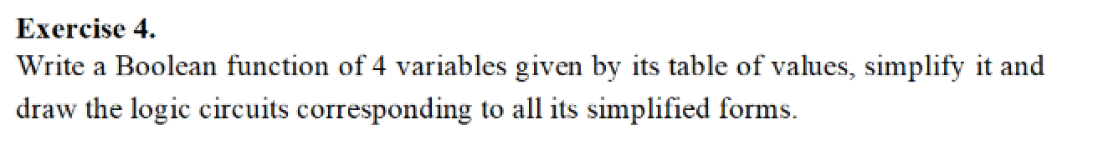
We will use Quine-Mc’Clusky’s simplification method for this exercise

Slide 3
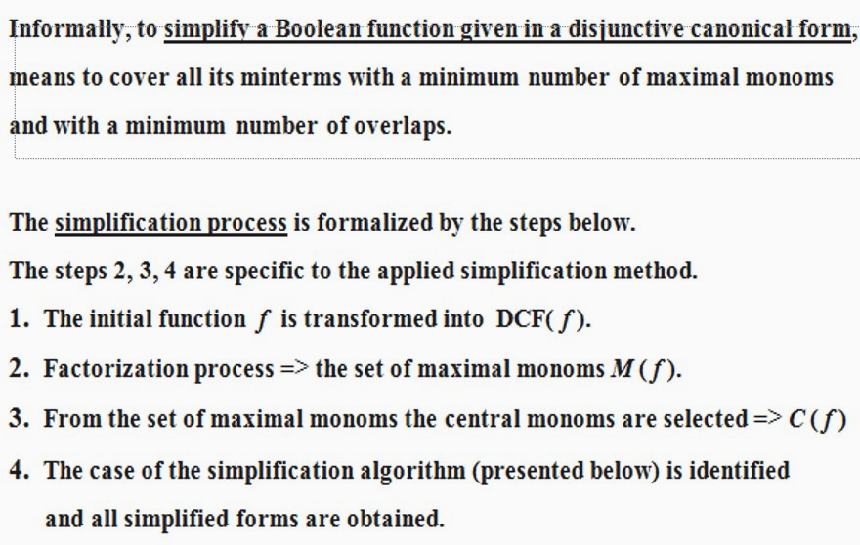
Theory (function part)

Slide 4
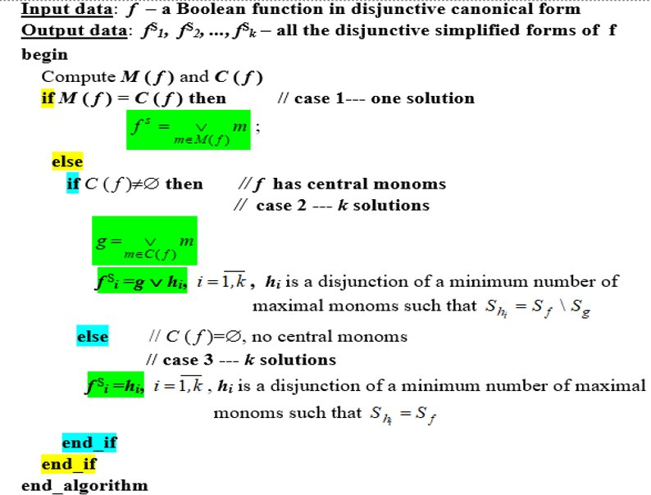

Slide 5
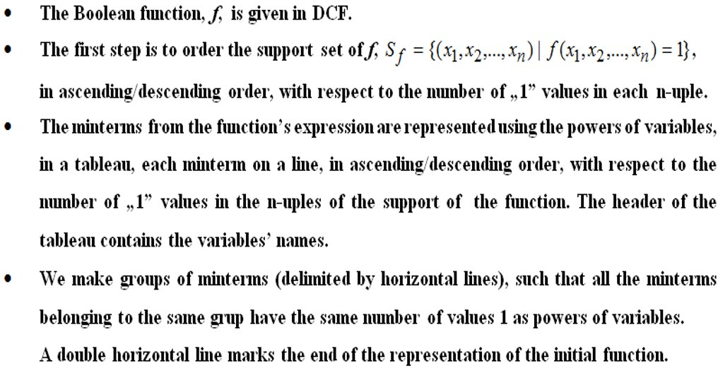
Part 1 of Quine’s method

Slide 6
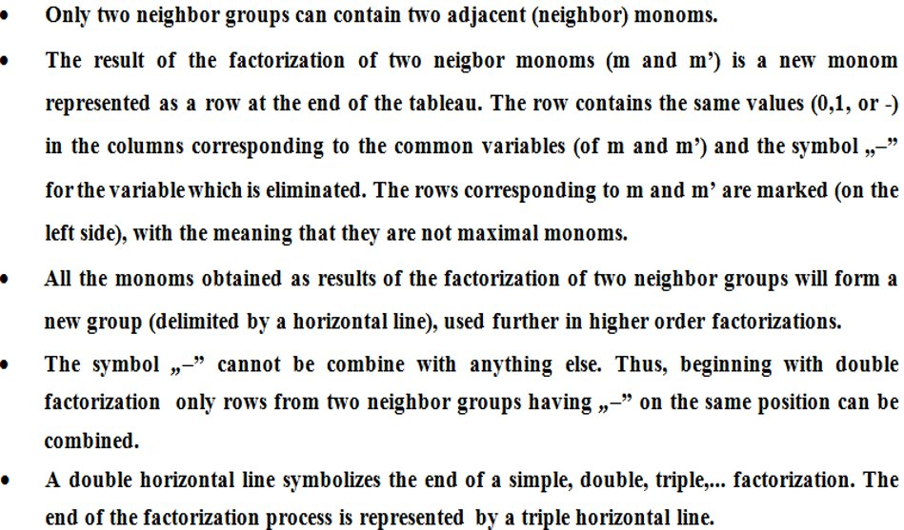
Part 2 of Quine’s method

Slide 7
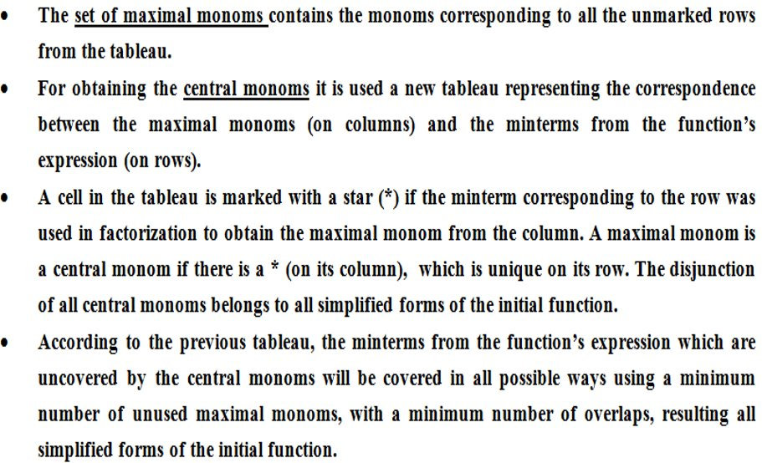
Part 3 of Quine’s method

Slide 8
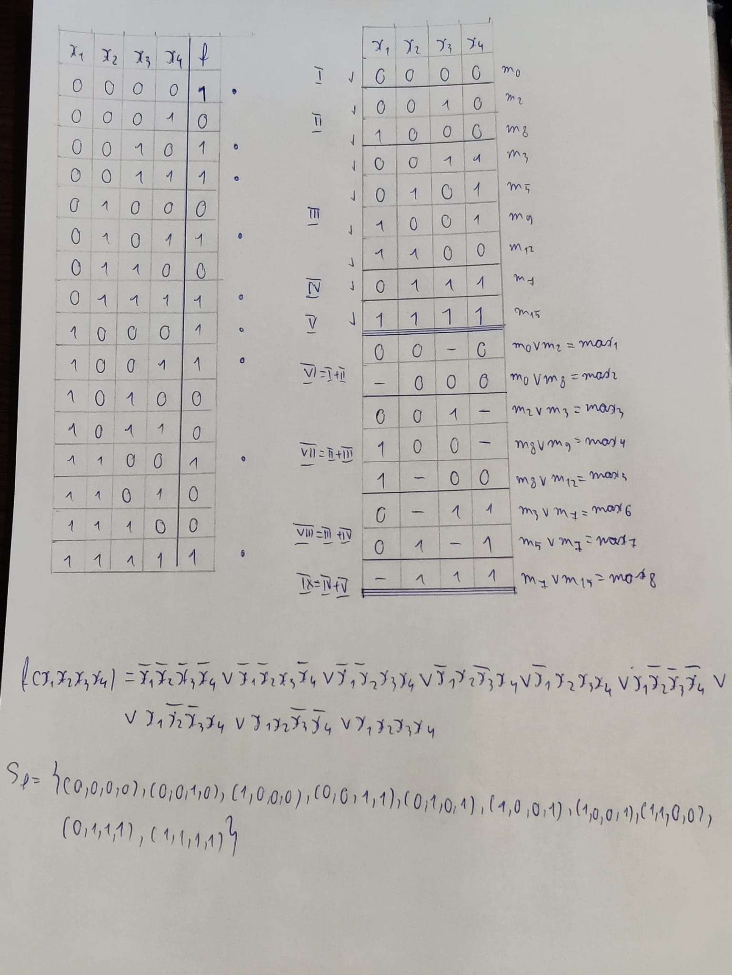
After we draw the table of variables and complete it randomly, we get the function f(x1,x2,x3,x4) written in the bottom of the page, consisting in 9 minterms
Now we try to simply the funfction, respecting the rules of the theory presented above and we end up with 8 max elements
Now we write the support of F (S f) in ascending order, based on how many 1’s the given number has in it’s binary representations, so we can fill the simplification talbe with the elements in that order

Slide 9
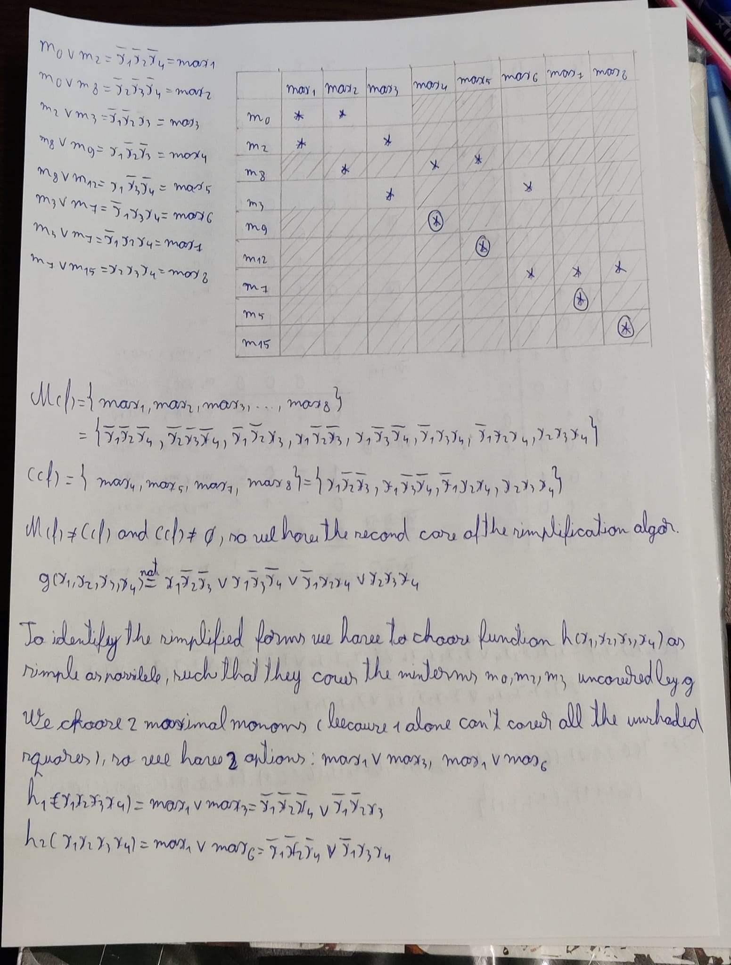
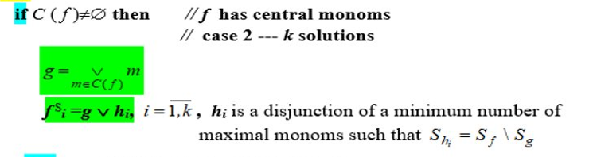
We write who the max elements are in explicit forms, we fill in the table and we get the C(f) containing 4 elements, so we find ourselves in the second case

Slide 10
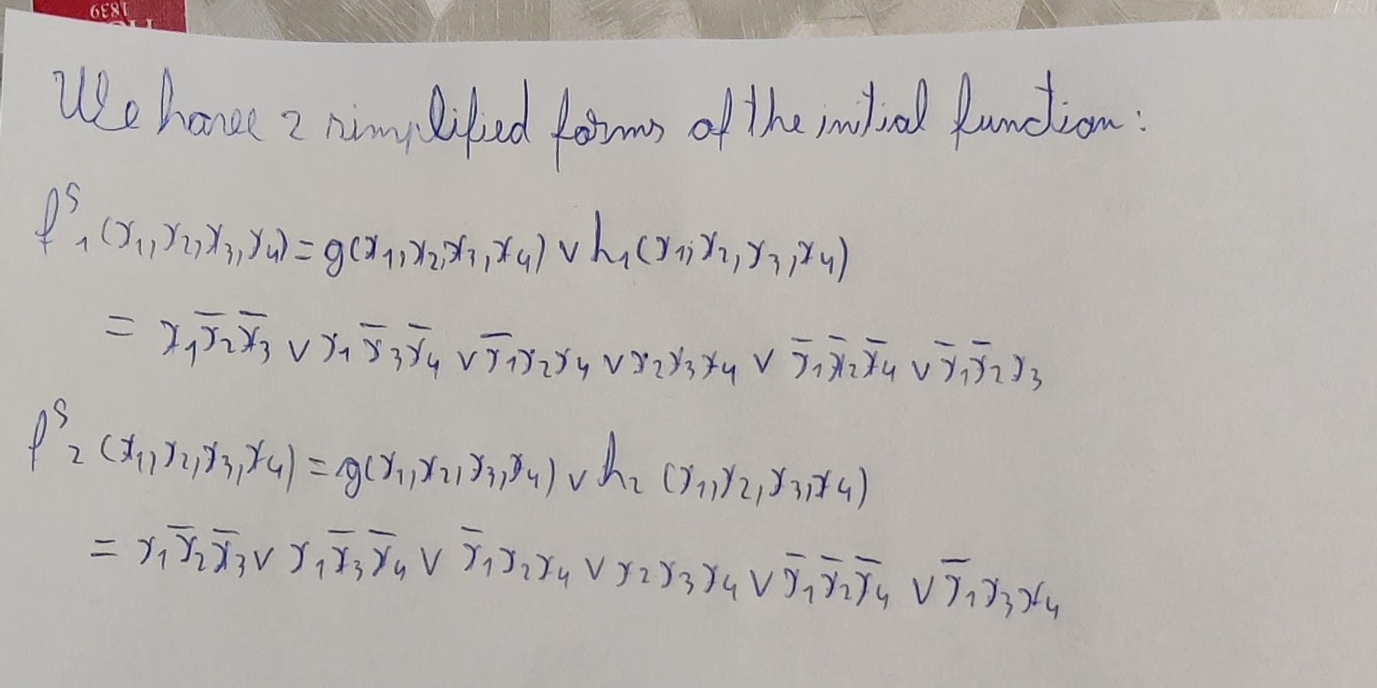
We end up with these 2 final simplified forms of the initial function F

Slide 11
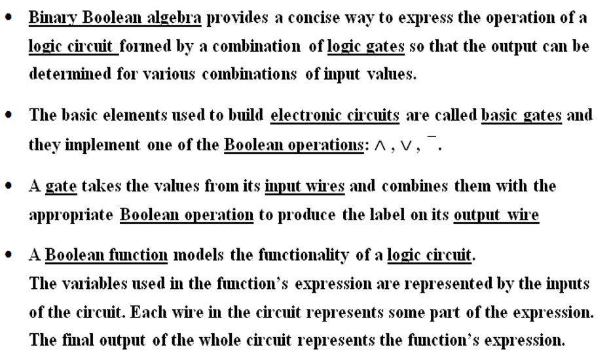
Theory (logical circuits part)

Slide 12
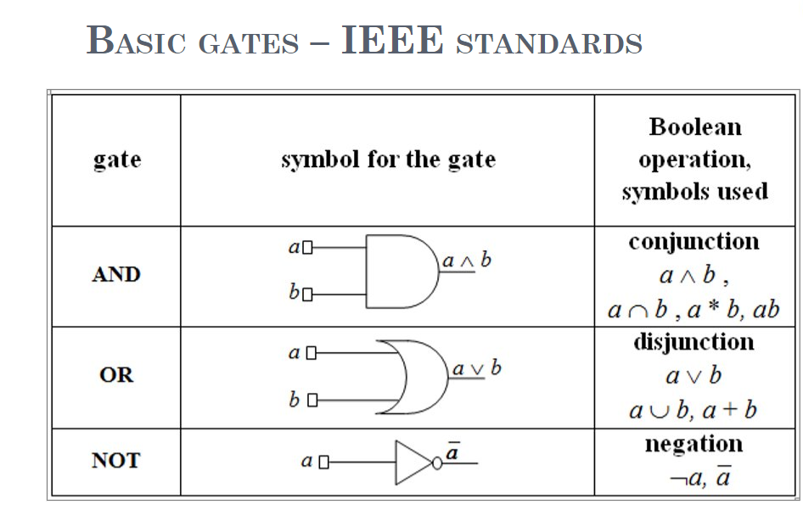

Slide 13
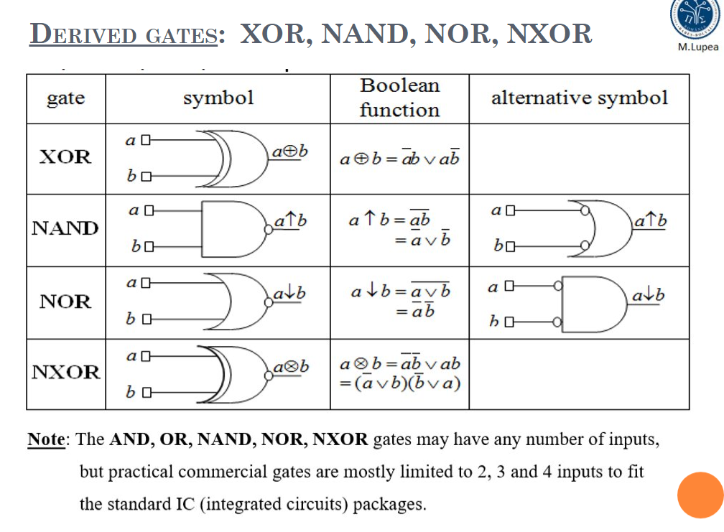

Slide 14
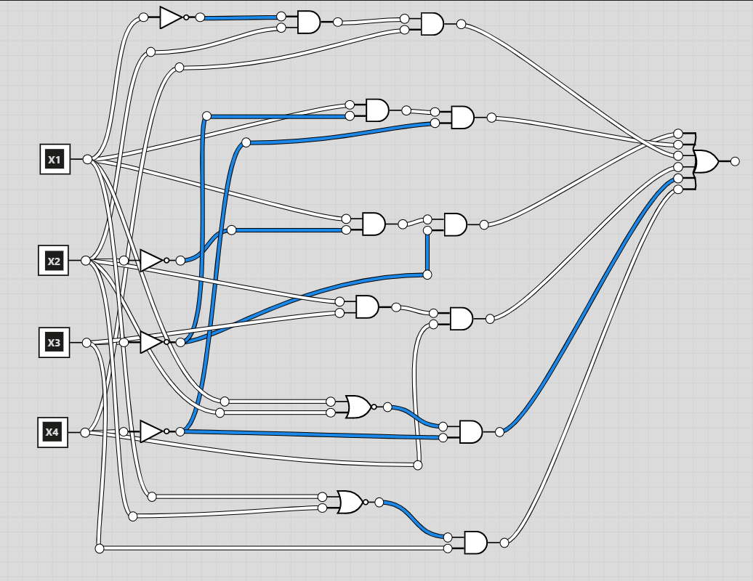
Using basic gates (and a few derived ones), we end up with the following logic circuit for the first simplified expression
I chose to draw the logic circuit digitally because it was too complex and if I drew it by hand, it would’ve been unreadable. Hope this isn’t an issue!

Slide 15
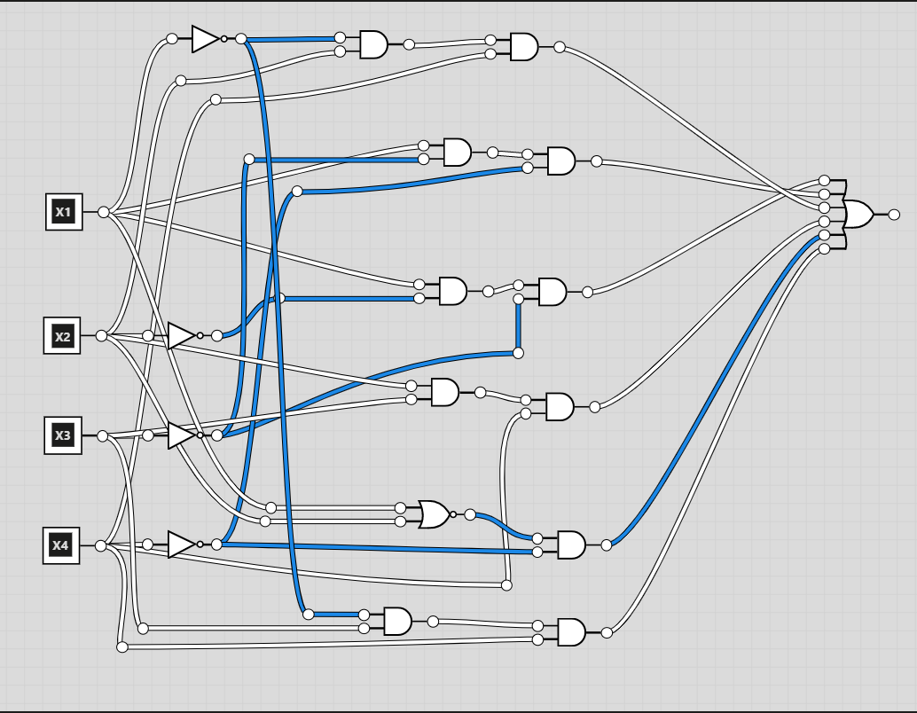
Here we have the logical circuit for the second simplified form

Slide 16
This was it, hope you liked it and hope I didn’t make any mistakes along the way! Thank you!

